Slide 1
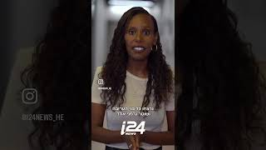
This is a video I wrote and produced for the Hebrew channel @i24news

